Slide 1
Static magnetic field using higher order hierarchic H(curl) conforming finite elements
https://github.com/kamearia/EMPY_Analysis/Static
High order Nedelec elements with local complete sequence properties
Joachim Schoberl and Sabine Zaglmayr
COMPEL: The International Journal for Computation and Mathematics in Electrical and Electronic Engineering, Vol. 24 No. 2, 2005
Hcurl(nograd=true order=8) for A
H1(order=8) for Ω
Python with netgen/ngsolve
( https://ngsolve.org/ )

Slide 2
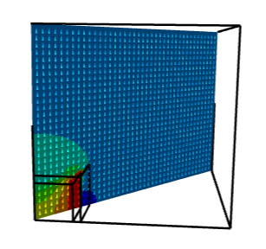
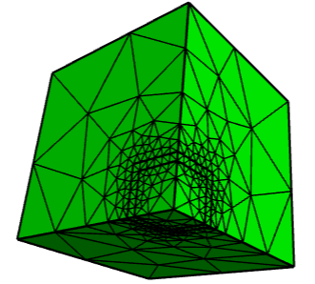
Cube 2m*2m*2m μr=1000
1/8 region with simmetricity
1T Uniform field in z direction
Total domain 1.2*1.2*1.2
Reduced domain 5*5*5
Bn=0 on the boundary
FE order 8
ICCG eps=10⁻⁸
nv= 384 nedge= 2151
nfacet= 3328 ne= 1560

Slide 3
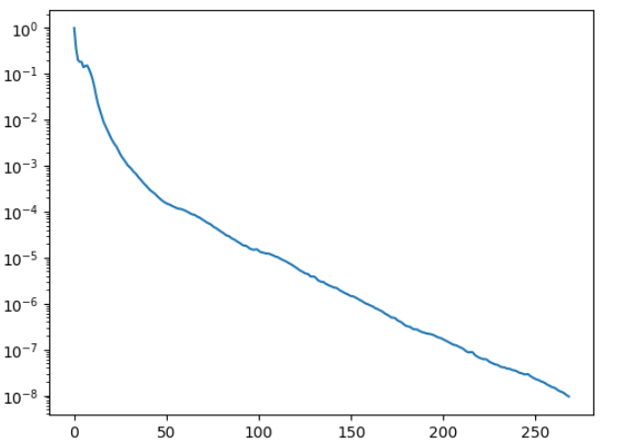
A-Ar
Dof= 315370
Nonzeros= 111303072
shift parameter= 1.02
minimum residual= 9.488181961272888e-09 at iteraions: 268
center magnetic field
= (1.2601636930633878e-11, -2.9647877868046543e-07, 3.446368332228351)
magnetic energy= 11541.379446089919
経過時間: 176.1111 秒

Slide 4
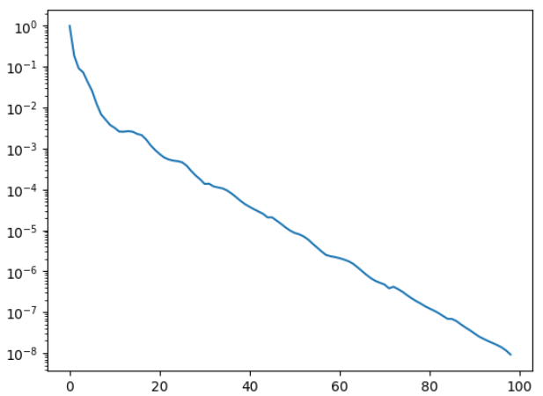
Ω-Ωr
Dof= 135944
Nonzeros= 34965270
shift parameter= 1.01
minimum residual= 9.234648703853246e-09 at iteraions: 98
center magnetic field
= (1.5102343358934567e-11, -4.231033382380488e-12, 3.4476356299040027)
magnetic energy= 11568.97631021465
経過時間: 28.7880 秒

Slide 5
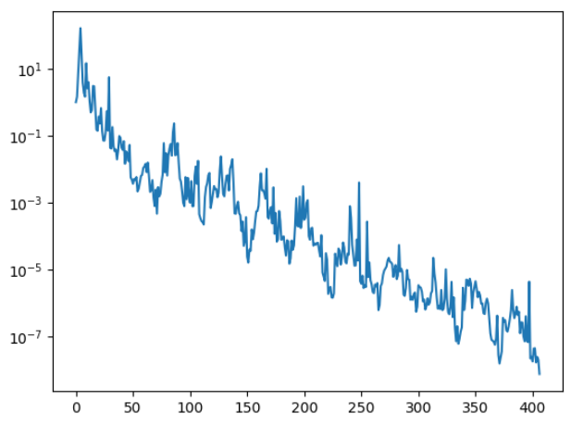
A-Ωr
Dof= 225059
Nonzeros= 71419621
shift parameter= 1.02
minimum residual= 7.435276405447754e-09 at iteraions: 406
center magnetic field
= (0.0, -2.4790426680963306e-07, 3.4463682167354857)
magnetic energy= 11541.379590852714
経過時間: 108.1370 秒

Slide 6
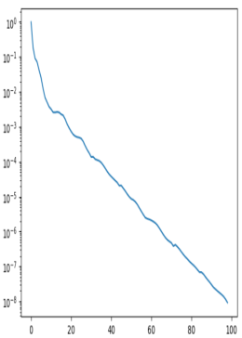
 | A-Ar | Ω-Ωr | A-Ωr
DOF | 315370 | 135944 | 225059
Nonzeros | 111303072 | 34965270 | 71419621
Niter | 268 | 98 | 406
Tcal | 176.1111 | 28.788 | 108.137
Bz*(T) | 3.4463683 | 3.4476356 | 3.4463682
Wm**(J) | 11541.379 | 11568.976 | 11541.380
A-Ar
Bz*(T): Bz at cube center (0,0,0)
Wm**(J): Magnetic energy in the cube
Ω-Ωr
A-Ωr

